Slide 1

SUPPLY CHAIN DISTRIBUTION NETWORK OPTIMIZATION FINAL PROJECT

Slide 2

Objective

Slide 3
Reduce Company’s Mileage Cost
By calculating the distance of two secondary DCs
determine which delivery point is most appropriate for the company in terms of optimized cost

Slide 4

Given Data

Slide 5

Geographical information of each city (zip codes, Latitudes and Longitudes) from USA
53 customers from different cities in USA.
Annual Sales to each customer
Actual distance to each customer from the current delivery point Little Rock.
Full Truck Load (FTL) 45000lbs
Estimated milage rate per mile.
Proposed new secondary distribution points, namely Fayetteville and Greenville.

Slide 6

Cost Calculation

Slide 7
( Annual Sale / FTL ) X Given Mileage
We will get actual mileage
Multiply Actual Mileage with $2
We will get the actual cost

Slide 8

Distance Calculation

Slide 9
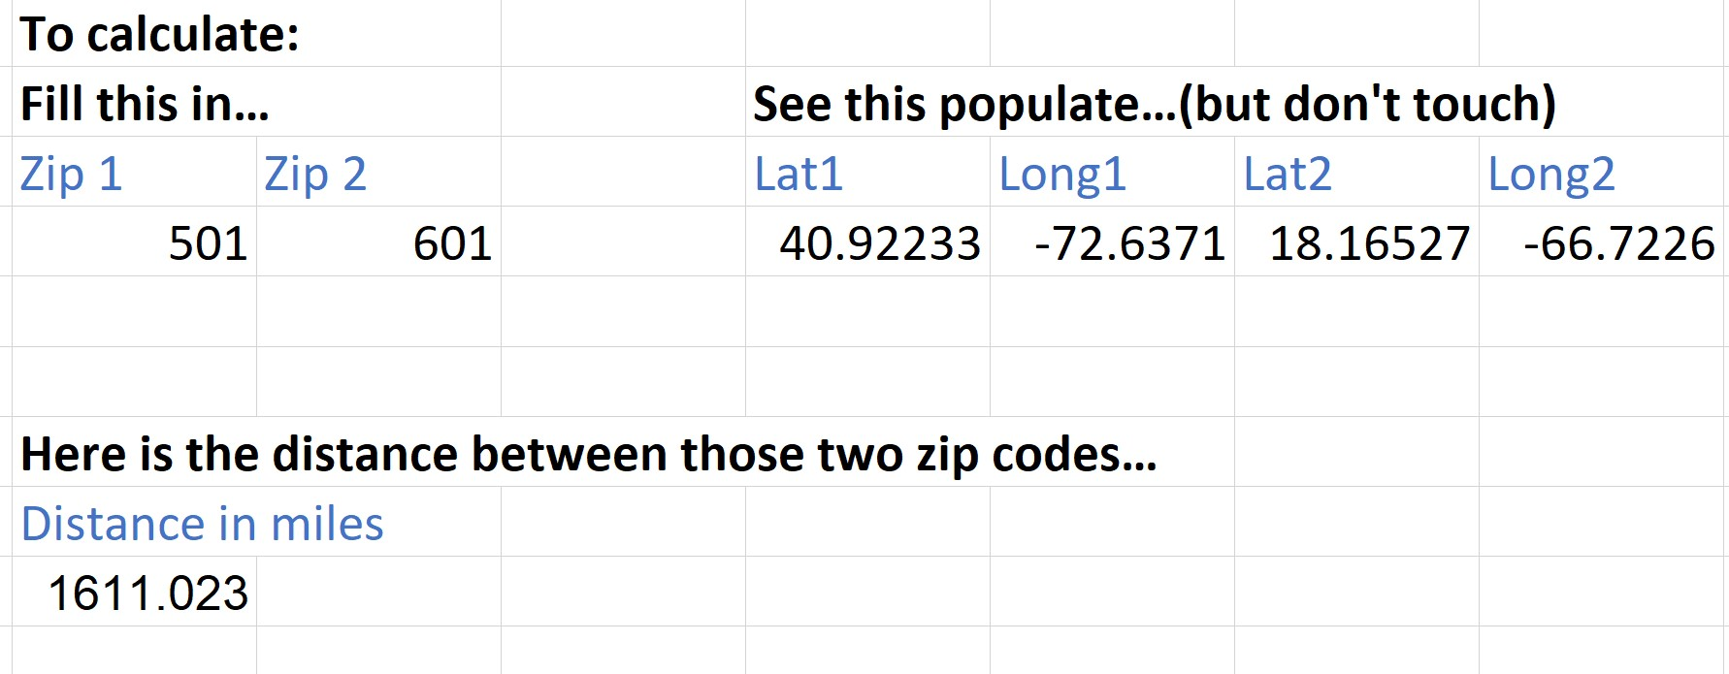

Check distance by changing between Zip Codes
Using
1: VLOOLUP
2: Excel formula to calculate distance between 2 (lat/lon) points (GPS positions)
VLOOKUP
Lat,Lon Calculation formula

Slide 10

Customer Location

Slide 11
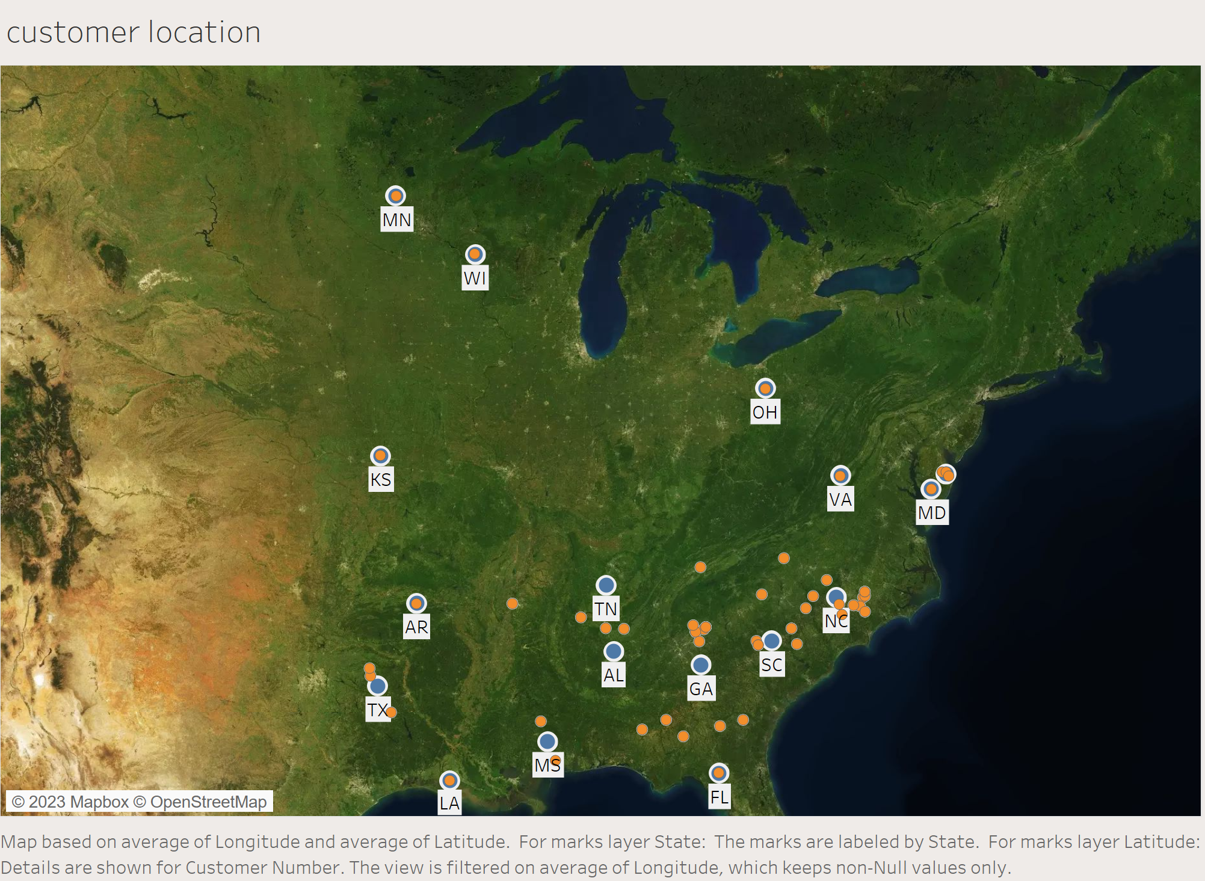

Slide 12

Distance Comparison

Slide 13
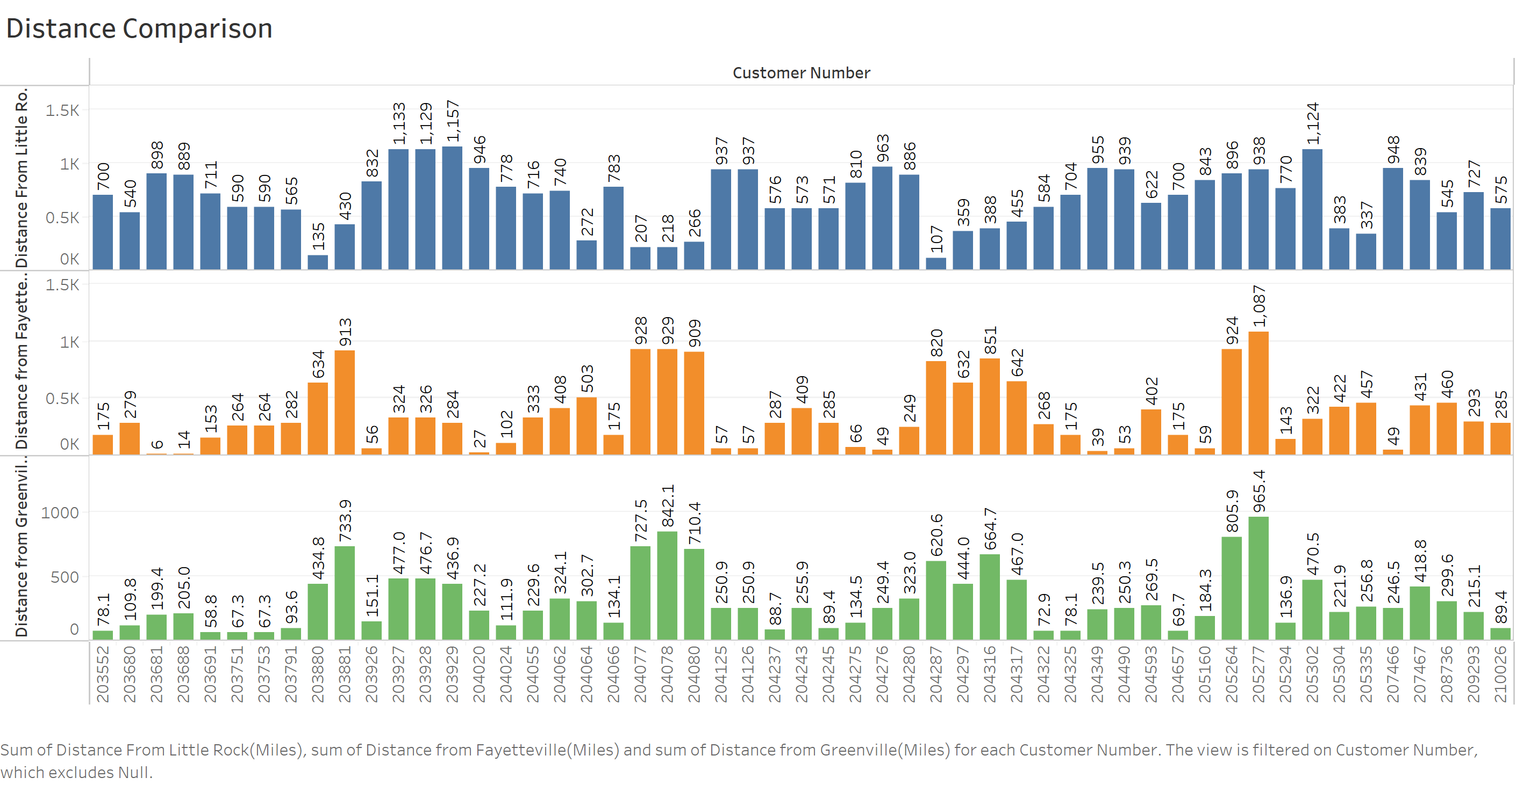

Slide 14

Cost Comparison

Slide 15
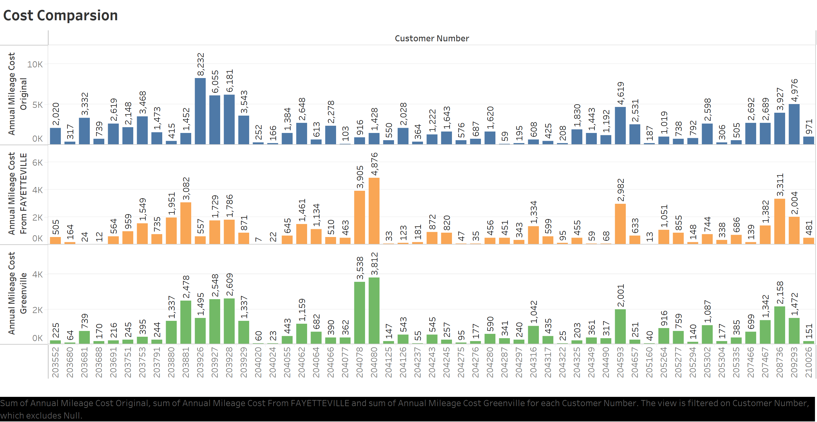

Slide 16

Distance Variation

Slide 17
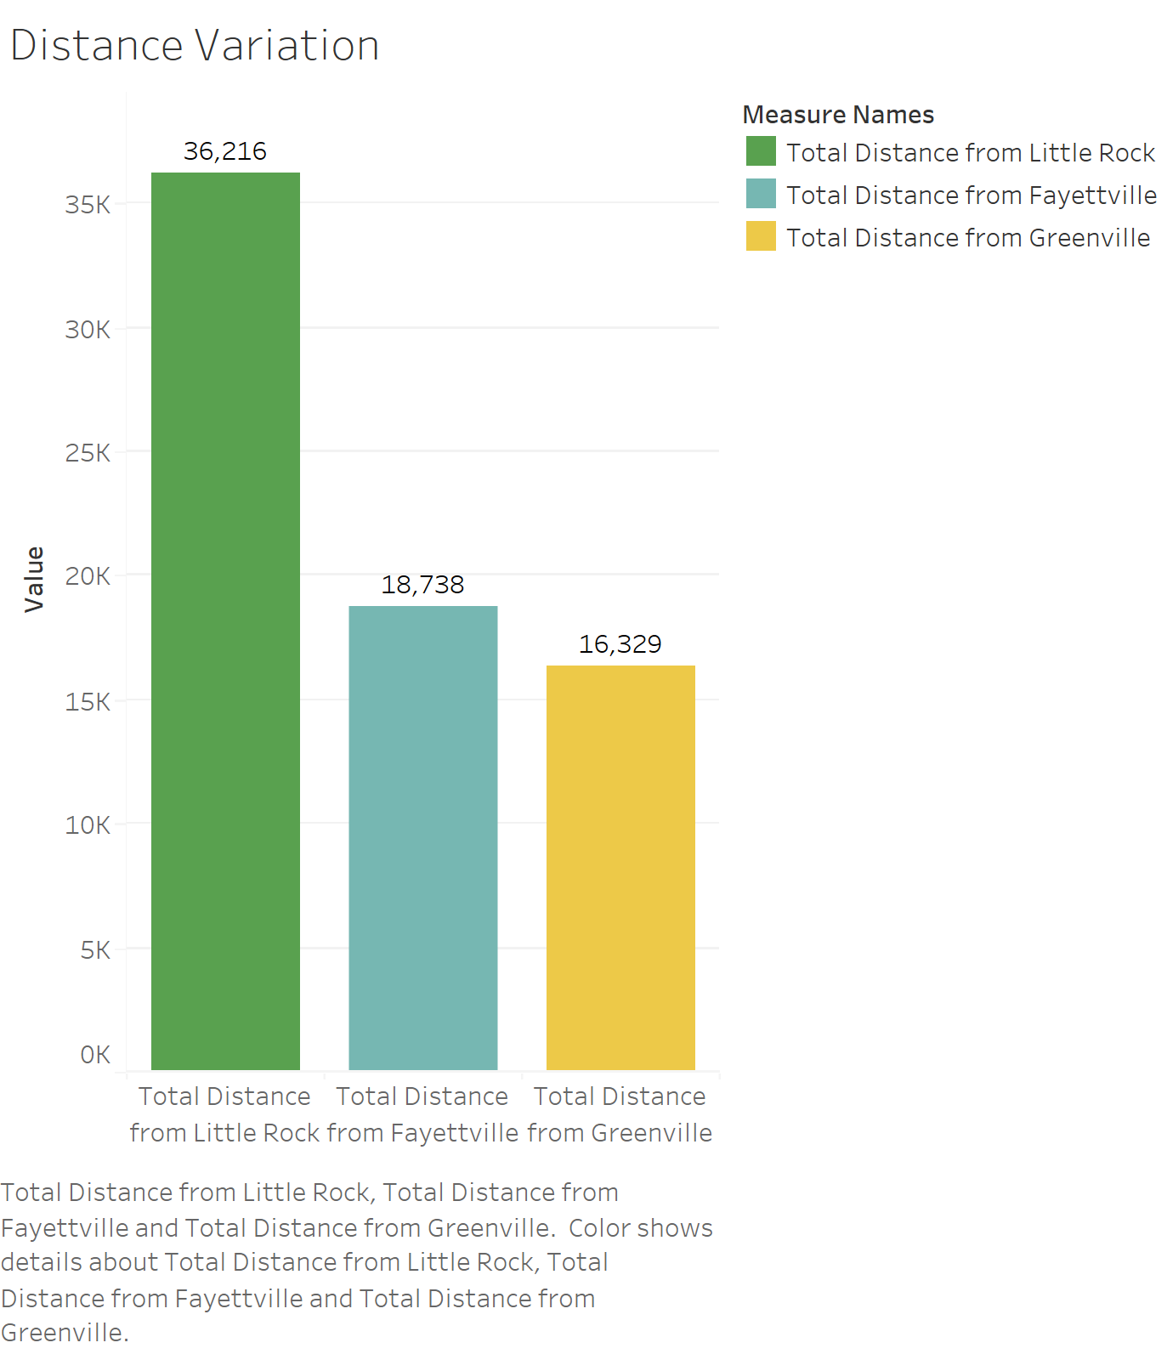

Slide 18

Final Cost Saving

Slide 19
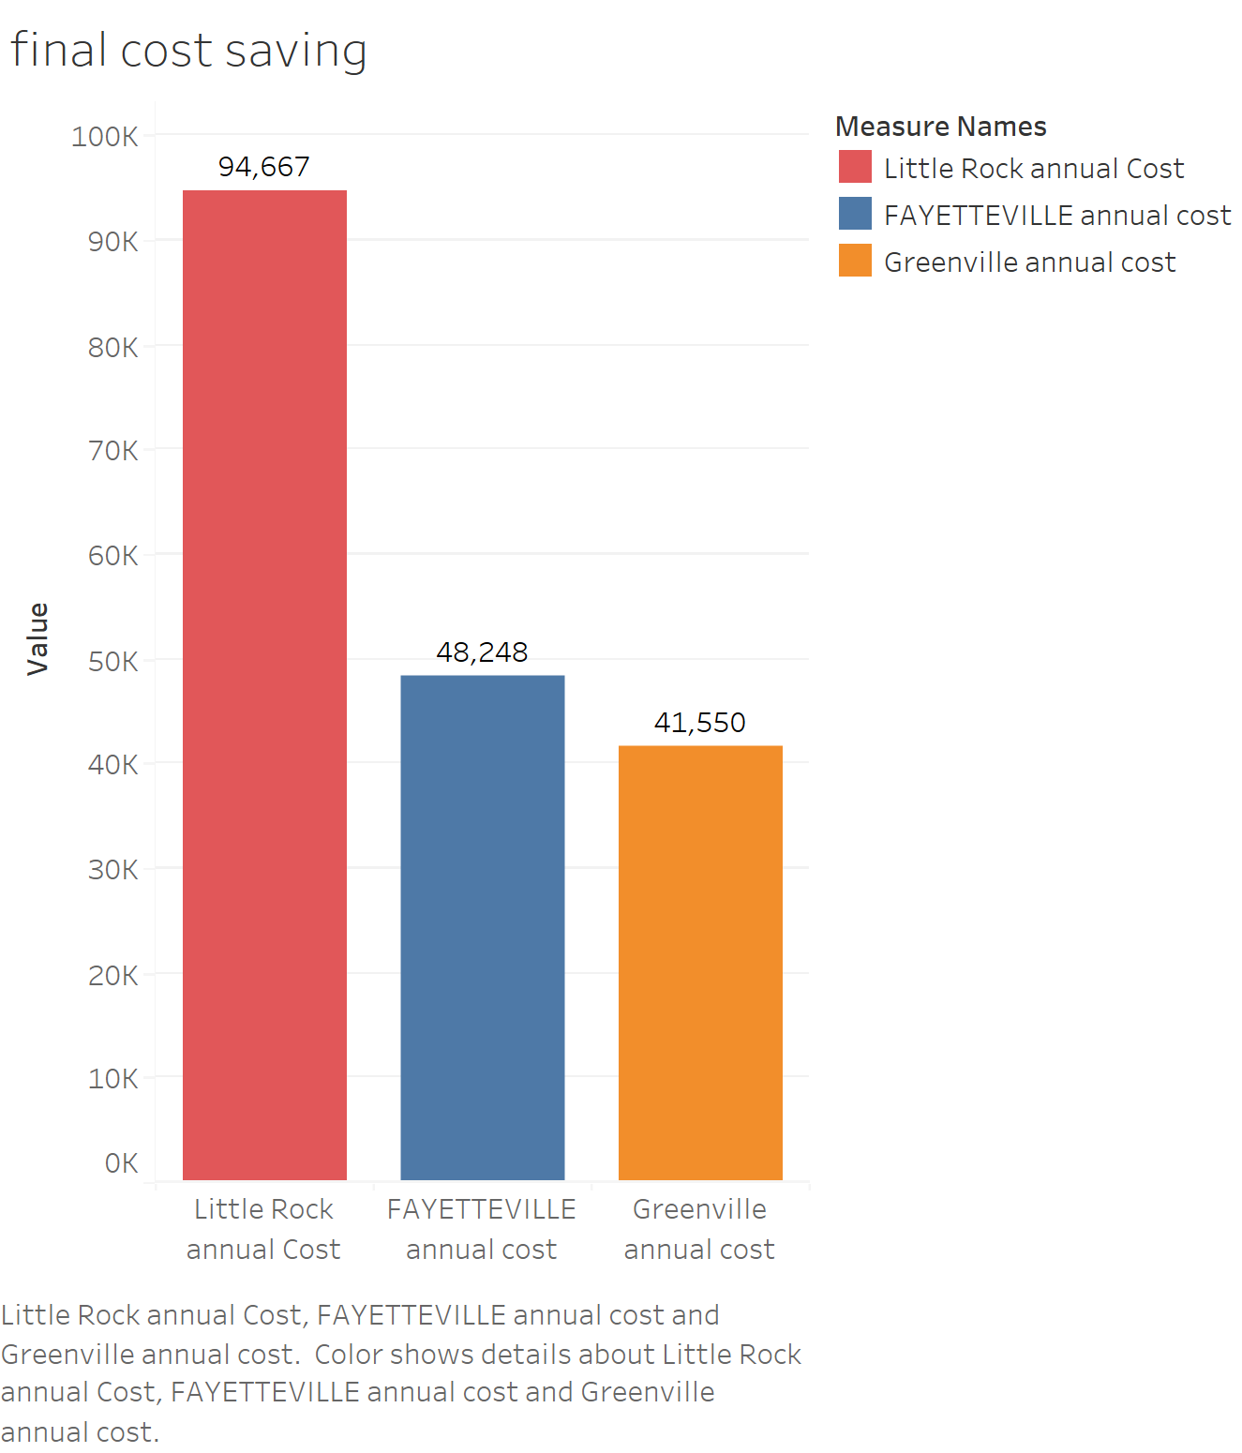

Slide 20

Dashboard

Slide 21
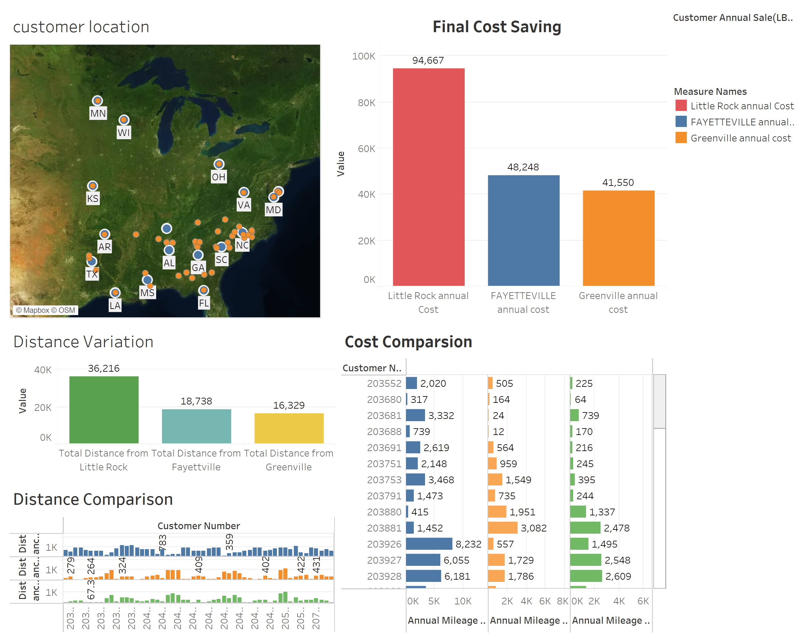

Slide 22

Thank You

